Slide 1
Kisan Buddy
PIP2001 Capstone Project
Final Review
Batch Number: 08
Under the Supervision of,
Dr. Srinivasan T R
Professor
School of Computer Science and Engineering
Presidency University
Student Name Roll Number
Shreya Paul - 20211CBD0002
K Faseeha Naaz - 20211CBD0012
Inzemam Quraishi - 20211CBD0026
Name of the Program: Computer Science and Engineering in Big Data.
Name of the HoD: Dr. Pravinthraja
Name of the Program Project Coordinator: Ms. Suma N G
Name of the School Project Coordinators: Dr. Sampath A K / Dr. Abdul Khadar A / Mr. Md Ziaur Rahman

Slide 2
Introduction
Kisan Buddy's primary goal is to empower farmers by introducing a bidding feature that ensures fair and competitive pricing for their produce. The program enables producers to sell their harvests to the highest bidder, eliminating middleman exploitation and fostering a more equitable agricultural economy.
In addition, Kisan Buddy provides farmers with real-time mandi (market) information, helping them identify nearby markets that offer the best pricing. The platform also includes location and transportation assistance, enabling farmers to make informed decisions and optimize their earnings effectively.
Unique Features
Market Analysis.
Bidding System.
User Access.
Ease of Application.

Slide 3
Objectives
Bridge the Gap Between Farmers and Consumers: Foster direct interactions between farmers and consumers, ensuring fair pricing and product quality.
Integrate Bidding: Create a platform for farmers to bid competitively.
Improve Accessibility: Create an intuitive and user-friendly system that enables easy login, registration, and navigation for both farmers and consumers, ensuring inclusivity for all users.
Provide Real-Time Market Data: Offer up-to-date pricing and bidding information to help farmers make informed selling decisions.
Location-Based Services: Offer location-based features that connect farmers with nearby buyers or sellers.
Enhance Product Transparency for Consumers: Allow consumers to check the quality of agricultural products and make purchases within their preferred price range.
Promote Digital Inclusion: Introduce technology to small-scale farmers by offering a straightforward platform with essential features, assisting their transition to a digital economy.

Slide 4
Existing method Drawback
Gaps Identified
Absence of platforms for digital bidding or direct negotiations.
Limited market insights and analytics.
Insufficient features to connect farmers directly to buyers or markets.
Lack of integrated transportation solutions.
User interface lacks simplicity and ease of use for farmers.
Digital Illiteracy.

Slide 5
Proposed Method
Provide farmers with updates on nearby market (mandi) prices.
Introduces a transparent bidding system.
Top bidders listing.
User-Friendly Design.
Secure Authentication.
Supports farmers with location-based insights.

Slide 6
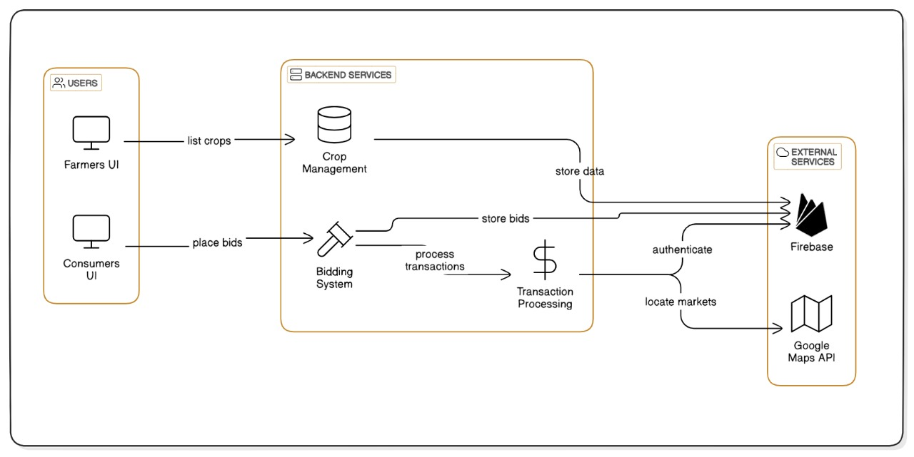
Architecture

Slide 7
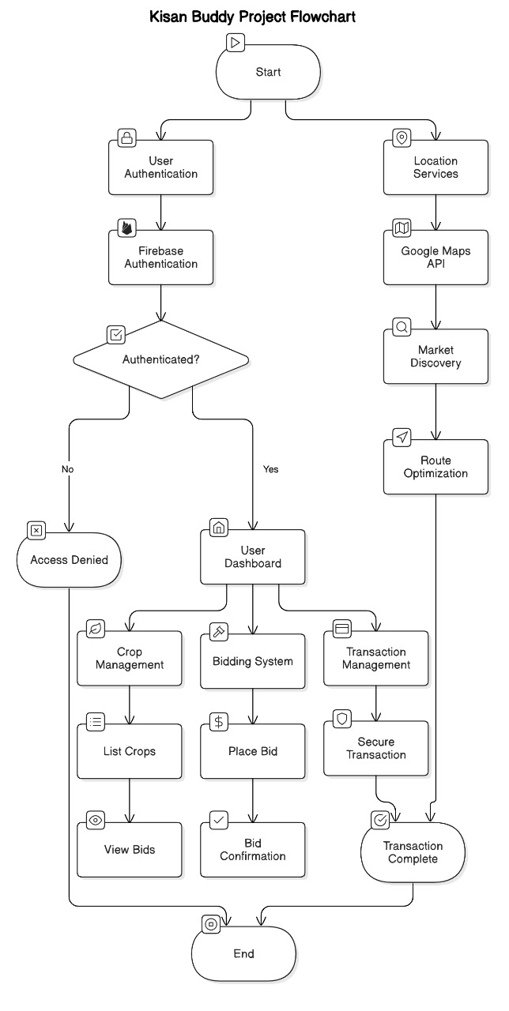
Architecture – Work Flow Diagram

Slide 8
Hardware/software components
Software:
Android Studio (version 4.2 or higher)
Firebase SDK (integrated with Android Studio)
Google Maps API Key (for accessing location services)
Hardware:
Smartphone/Tablet: Android 7.0 or higher for running and testing the app.
Laptop/PC: For development with Android Studio (minimum 8GB RAM and 10GB storage space).
Internet Connection: Required for Firebase and Google Maps services.

Slide 9
Modules
Splash Screen and Registration Page.
Login Page and Profile page.
Crop Entry and Producer dashboard.
Consumer Dashboard and Customer List.
Bid Settlement and Location Access.

Slide 10
Methodology
Splash Screen and Registration Page
The app's initial screen acts as a welcoming interface, showcasing the logo and name while loading core features, creating a powerful first impression. New users can easily set up an account on the registration page by inputting essential information like name, contact details, and a secure password, ensuring a smooth onboarding process for full app access.
Login Page and Profile page
Existing users can safely enter their accounts through the login page by providing their registered email and password, guaranteeing effortless app entry. Users can view and modify their personal information, including name, contact details, and preferences, on the profile page, allowing for a tailored app experience.
Crop entry and Producer Dashboard
Producers can effortlessly input crop information in the crop entry section, such as name, quantity, weight, and price per kilogram, facilitating a straightforward listing process for potential buyers. The producer dashboard offers a thorough overview of active crop listings, showing crop names, seller information, prices, and bids, enabling producers to effectively manage their offerings and track market demand.

Slide 11
Methodology
Consumer Dashboard and Customer List
The consumer dashboard presents an organized display of available crops, including crop names, sellers, prices, and current bids, allowing consumers to easily browse and participate in bidding. The customer list page provides a detailed view of registered customers, displaying their names, bid amounts, and email addresses, facilitating efficient management and communication between producers and consumers.
Bid Settlement and Location Access
On the bid settlement page, farmers can evaluate and choose the most lucrative bid from consumers. They can finalize the transaction by selecting "Yes" or decline and wait for a better offer by choosing "No." The location access page displays a visual representation of producer, consumer, and mandi locations, enabling efficient navigation and optimized delivery routes for improved decision-making and profitability.

Slide 12
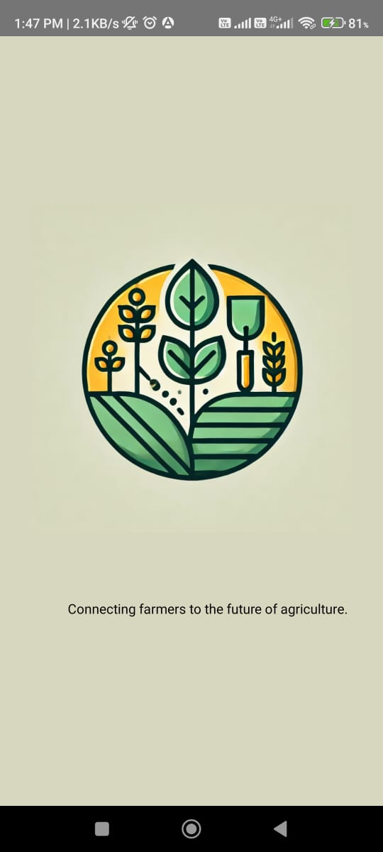
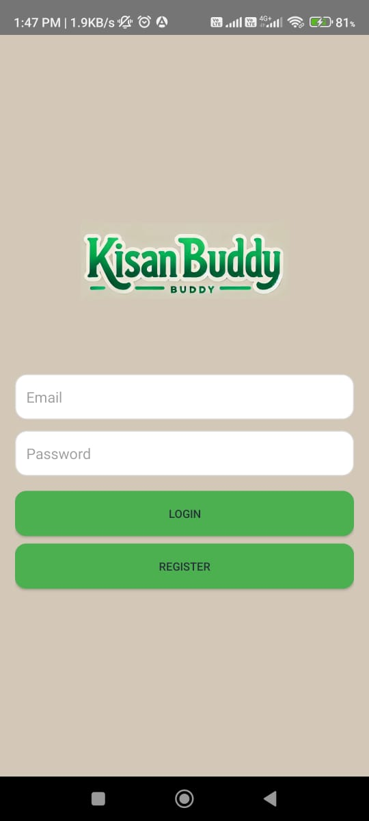
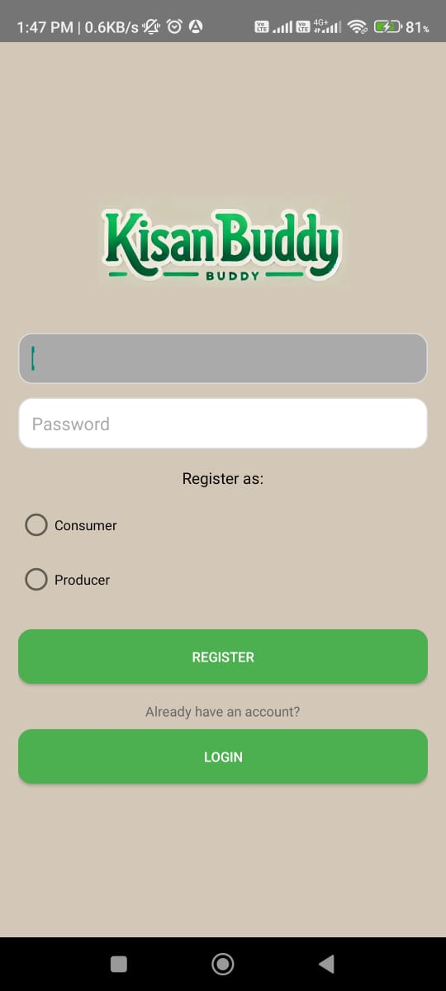
Output

Slide 13
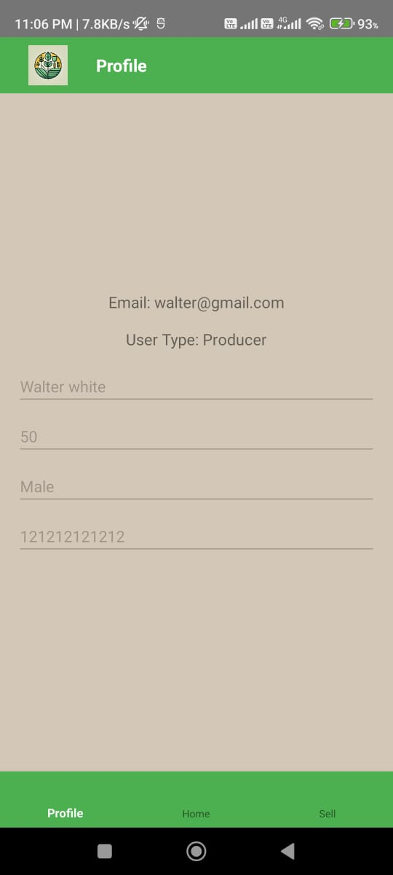
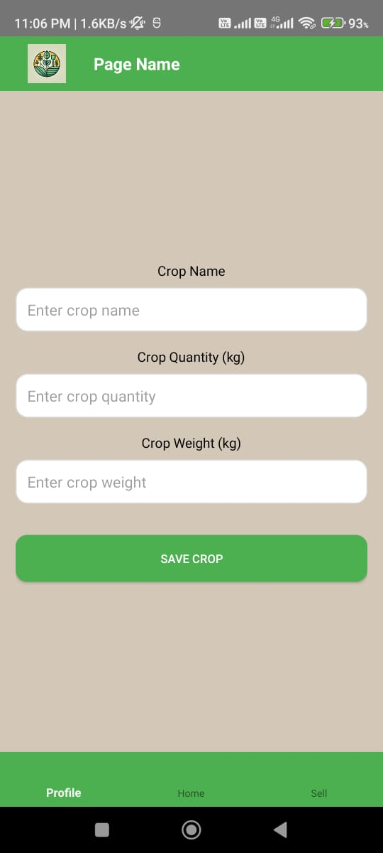
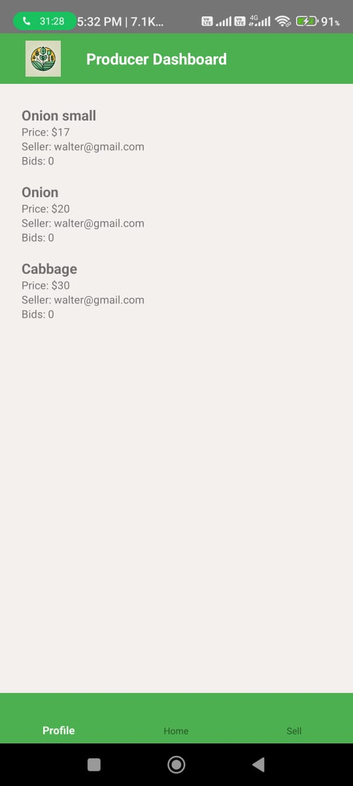
Output

Slide 14
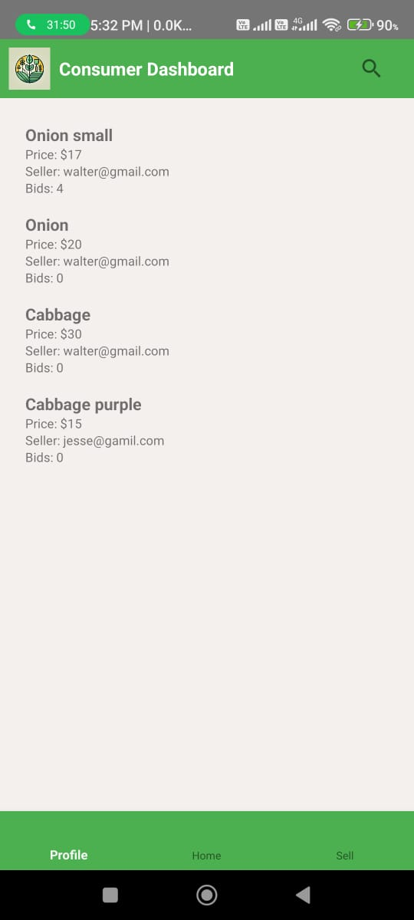
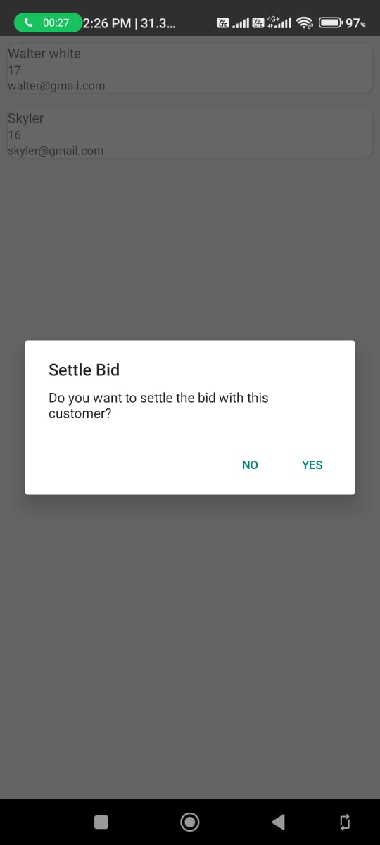
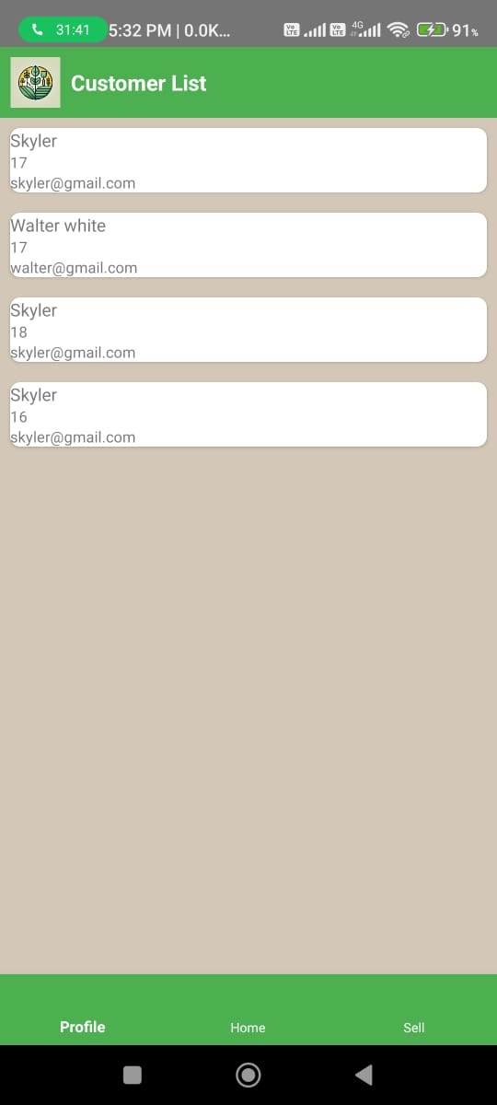
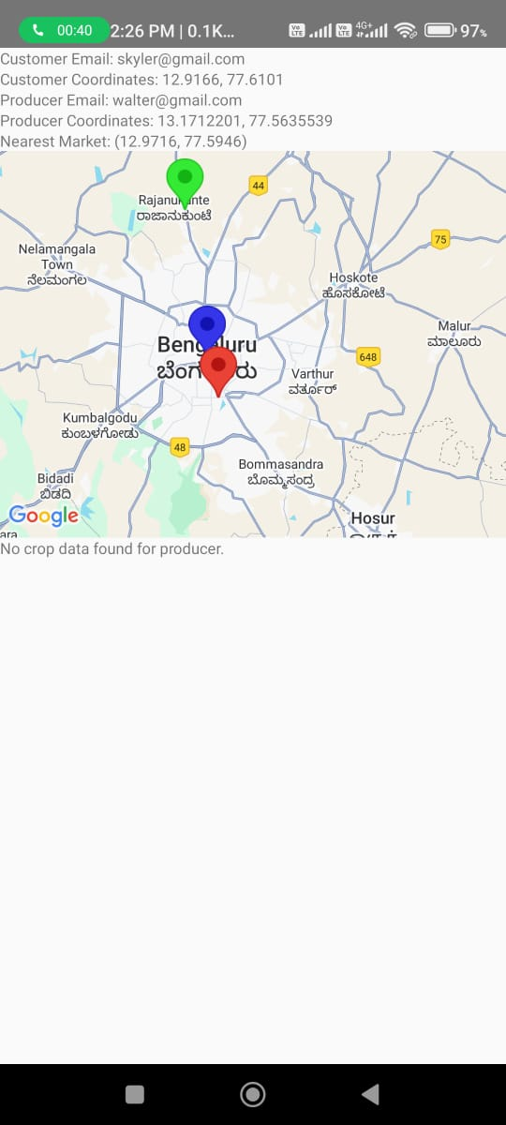
Output

Slide 15
Github Link
Click here!!

Slide 16
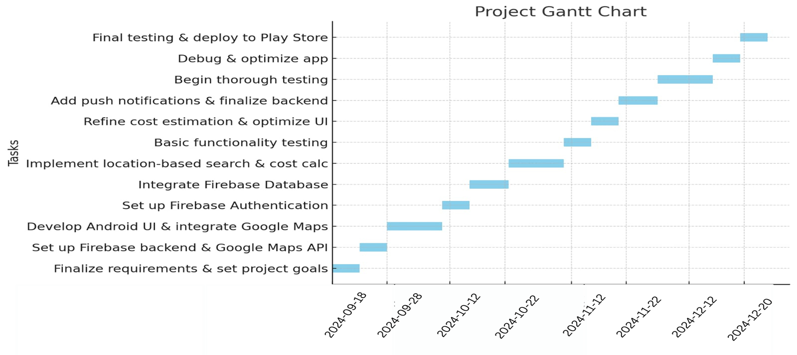
Timeline of Project

Slide 17
Conclusion
The Kisan Buddy project effectively addresses the needs of farmers and consumers by offering a user-friendly platform for crop management, bidding, and transactions. Producers can list their crops and interact with buyers through a bidding system, while consumers can easily view available produce and place bids. The integration of location services facilitates efficient market discovery and route optimization to reduce travel costs, enabling smooth transactions between parties.
The use of Firebase for authentication and real-time data storage ensures secure and seamless user experiences. By incorporating Google Maps API, the app enhances usability by allowing users to locate nearby markets and producers. These combined features result in a comprehensive tool that connects farmers and consumers, improving accessibility and efficiency in the agricultural sector.
In summary, the Kisan Buddy app represents a significant advancement in utilizing technology for agricultural growth. The project not only simplifies transactions but also promotes fair trade and transparent communication between producers and consumers. Looking ahead, further improvements can be made to expand the app's reach and capabilities, ultimately contributing to the modernization of farming practices.

Slide 18
References
[1]. Arjune, S. and Srinivasa Kumar, V. (2022) ‘Smart Agriculture adoption based on Farmer's Perspective’, 2022 International Interdisciplinary Humanitarian Conference for Sustainability (IIHC), Bengaluru, India, pp. 376-379, doi: 10.1109/IIHC55949.2022.10060306.
[2]. Bisheko, M. J. and R. G. (2023) ‘A study on farmers' perceptions about the scope of the Kisan Suvidha App in improving agricultural sustainability’, 2023 Conference on Information Communications Technology and Society (ICTAS), Durban, South Africa, pp. 1-5, doi: 10.1109/ICTAS56421.2023.10082741.
[3]. Chowdhury, M., Rahman, M. O. and Alam, S. (2024) ‘Proprietor: A Farmer Assistance Smartphone Application with Crop Planner, Crop Disease Help, Agri-expert Search, and Crop Suggestion Features’, 2024 15th International Conference on Computing Communication and Networking Technologies (ICCCNT), Kamand, India, pp. 1-6, doi: 10.1109/ICCCNT61001.2024.10725364.
[4]. Isafiade, O. and Mabiletsa, O. (2020) ‘Immersive Technologies for Development: An Analysis of Agriculture’, 2020 ITU Kaleidoscope: Industry-Driven Digital Transformation (ITU K), Ha Noi, Vietnam, pp. 1-8, doi: 10.23919/ITUK50268.2020.9303205
[5]. Kumar, D. and Phougat, S. (2022) ‘Status of Pradhan Mantri Kisan Samman Nidhi (PM-KISAN) Scheme’, book, pp. 28–36.

Slide 19
References
[6]. Kumar, P., Tyagi, R., Kathpalia, J. and Bangarh, A. (2024) ‘Knowledge of Mobile Applications in Digital Agriculture among Haryana Farmers: A Socio-economic Perspective’, International Journal of Education and Management Studies, vol. 14, no. 2, pp. 222–226.
[7]. P, V., P, R., T S, K. S., Rao, P. M., P, V. and A, T. (2023) ‘Farm Connect Application: Bridging the Gap Between Farmers and Consumers Through Digital Technology’, 2023 International Conference on Sustainable Emerging Innovations in Engineering and Technology (ICSEIET), Ghaziabad, India, pp. 225-230, doi: 10.1109/ICSEIET58677.2023.10303471.
[8]. Vashista, S., Dubey, A. K., Goyal, A. and Vashisth, R. (2022) ‘Design and Implementation of AI-based Kisan Se Kisan Tak (KSKT) Mobile App’, 2022 International Mobile and Embedded Technology Conference (MECON), Noida, India, pp. 408-413, doi: 10.1109/MECON53876.2022.9752052.
[9]. Xu, J.-H., Lin, G.-D., Tan, J.-Y. and Xue, J.-Z. (2023) ‘Multi-Agent-Based Optimal Bidding Strategy for Power Producer in Power Market’, 2023 International Conference on Machine Learning and Cybernetics (ICMLC), Adelaide, Australia, pp. 564-568, doi: 10.1109/ICMLC58545.2023.10328004.
[10]. Yadav, T., Sable, P. and Kalbande, D. (2023) ‘SMART KISAN: A Mobile App for Farmers' Assistance in Agricultural Activities’, 2023 International Conference on Smart Systems for applications in Electrical Sciences (ICSSES), Tumakuru, India, pp. 1-6, doi: 10.1109/ICSSES58299.2023.10199471.

Slide 20
Project work mapping with SDG
SDG 1: No Poverty
Effect: "Kisan Buddy" contributes to poverty reduction by boosting farmers' earnings.
Method: The application enables farmers to secure better prices for their produce by offering a direct marketplace, removing middlemen, and enhancing pricing and logistics. This leads to improved financial conditions for farmers and diminishes rural poverty.
SDG 8: Decent Work and Economic Growth
Effect: The application fosters economic development and generates new job prospects in rural regions.
Method: By expanding farmers' access to consumers and simplifying crop sales, the app aids rural farmers in achieving economic success. It also promotes the expansion of local transportation services and related agricultural sectors, creating quality employment opportunities within these communities.
SDG 10: Reduced Inequality
Effect: "Kisan Buddy" helps narrow the gap between large-scale and small-scale farmers.
Method: The application provides all farmers, regardless of their size or location, equal access to the marketplace, fair pricing, and essential tools for economic improvement. This approach reduces disparities between larger and smaller agricultural producers, promoting more inclusive opportunities for rural farmers.

Slide 21
Thank You

